Slide 1

Chemical Plume Analysis
Rodney Cordova

Slide 2
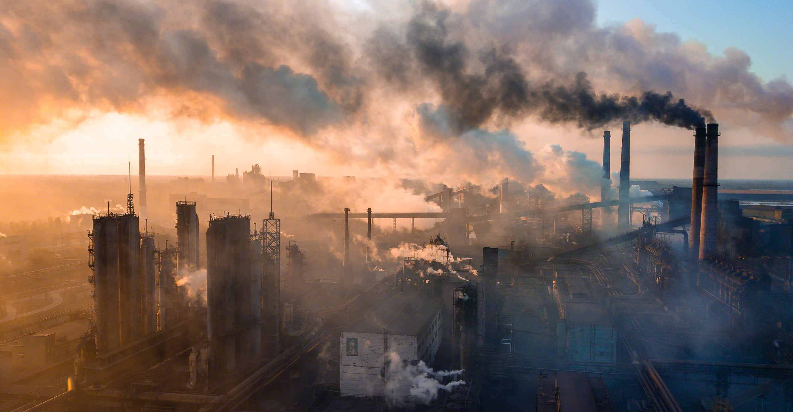
Assess
A local college has discovered signs that population of nesting pairs of Rose-Crested Blue Pipit.
These birds a sensitive to chemical air pollutants.
It is suspected that local factories may releasing chemicals impact the wildlife
Data has been collected by a grid of 9 sensor on the hour chemical levels

Slide 3
Best Path
Output
1) Assess the sensor performance
If the sensors are not working as expected it may be difficult to draw conclusions.
2) Examine the Chemical being detected
3) Predict the responsible factories
Identify the factories responsible for the chemical emissions.
Number of readings attributed to that factory
Total Detected Emission Level from each factory.

Slide 4
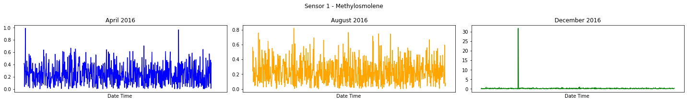
Data
Sensor Data
9 sensor each recording
4 Chemicals
1 once an hour
3 months
Meteorological Data
Wind direction and Windspeed readings
1 reading every 3 hours from central location.

Slide 5
Sensor performance: Anomaly Detection
Use unsupervised ML model to detect analysis readings
K-Mean – k=2 (normal vs anomaly)
Isolation Forest
Sensor | K-Means | Isolation Forest
1 | 11.7% | 11.7%
2 | 0.1% | 0.2%
3 | 1.5% | 12.4%
4 | 0.7% | 1.7%
5 | 0.7% | 2.1%
6 | 1.6% | 2.9%
7 | 0.2% | 3.8%
8 | 0.2% | 0.5%
9 | 100% | 81.3%

Slide 6
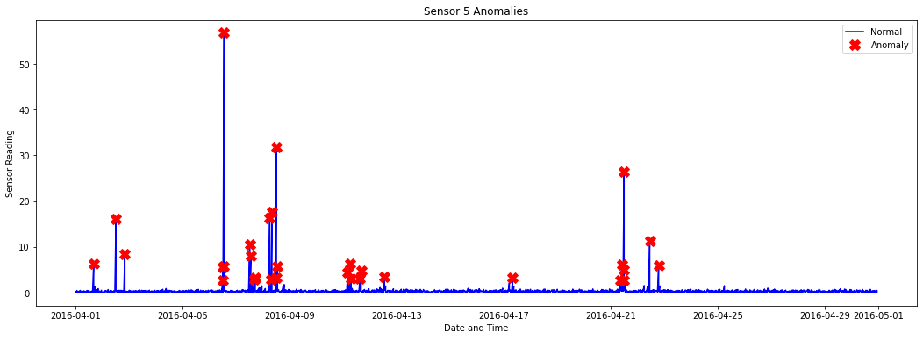
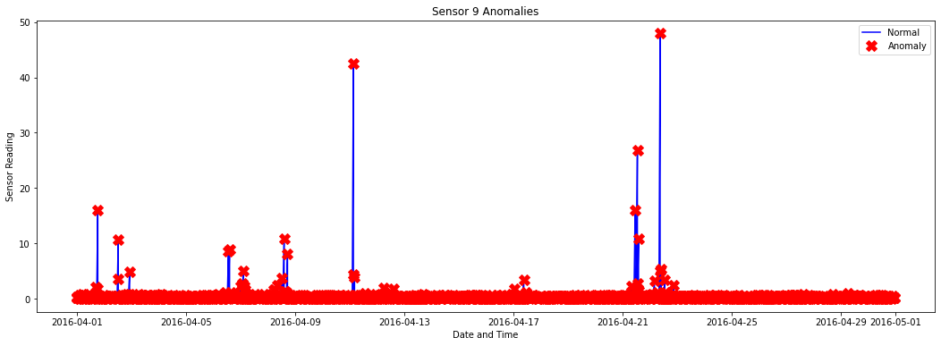

Slide 7
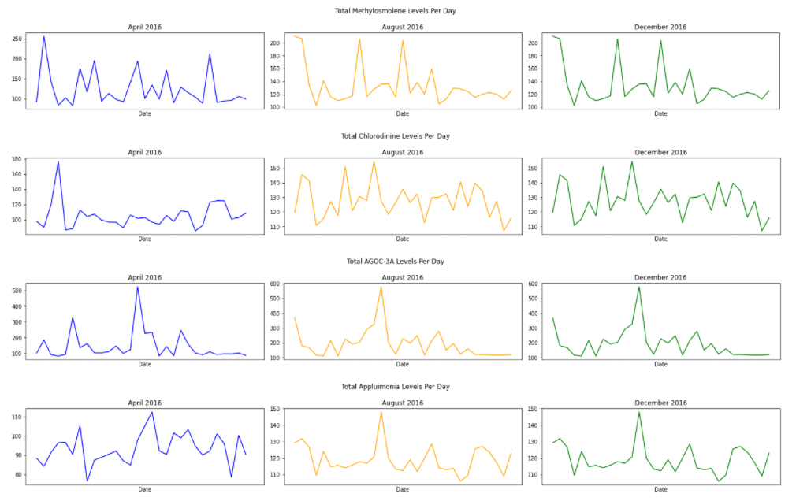
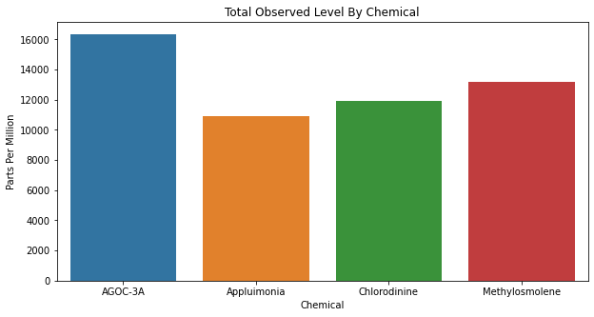
Chemicals

Slide 8
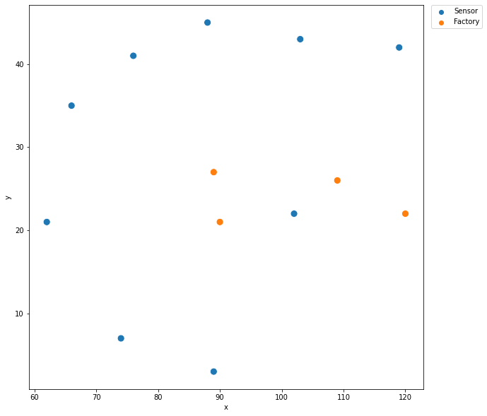
Factories
Sensor | Road Runner | Kasios | Radiance | Indigo
1 | 10.58 | 0 | 316.30 | 244.27
2 | 163.16 | 147.08 | 198.91 | 92.07
3 | 19.63 | 31.49 | 335.11 | 15.17
4 | 347.16 | 329.56 | 352.52 | 268.12
5 | 185.21 | 180.27 | 127.98 | 111.78
6 | 57.33 | 50.53 | 315.49 | 0
7 | 23.98 | 29.13 | 321.49 | 349.95
8 | 279.94 | 277.33 | 7.26 | 318.95
9 | 11.07 | 27.29 | 21.29 | 99.92

Slide 9
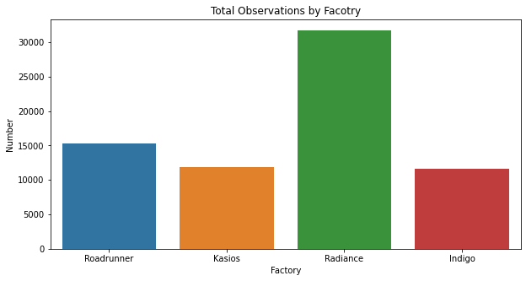
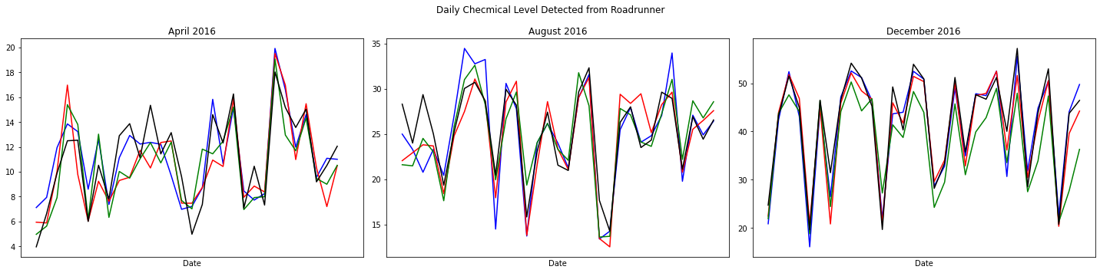

Slide 10
Time breakdown
Assess the project - 30%
Data Preparation / Analysis – 60%
Experiment – 30%

